Slide 1
COMPUTER NETWORKS
SESSION 05
IP Addressing Practice classless
Santoso Budijono

Slide 2
Learning outcomes
LO 2: Explain basic concepts of network
LO 3: Design network environment using TCP/IP Model

Slide 3
Outline
Classfull vs Classless
Design Subnetting

Slide 4
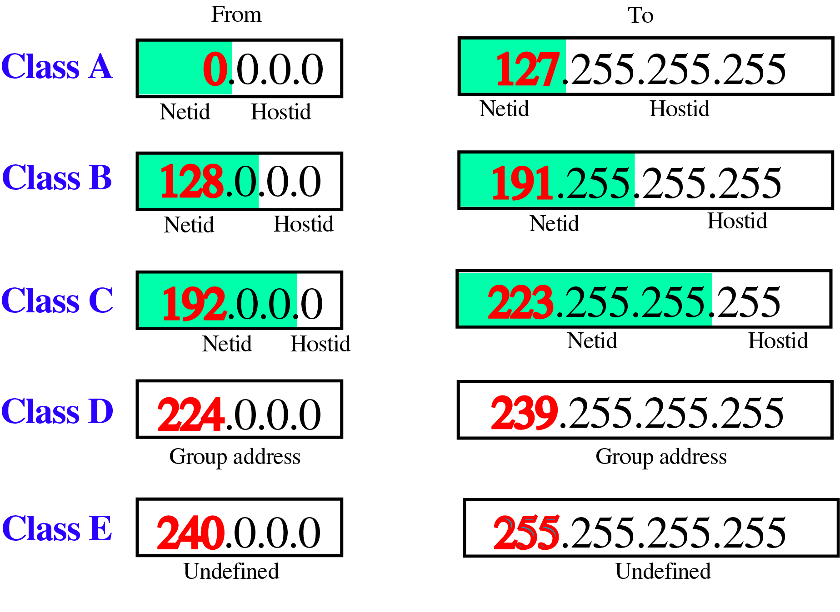
Classful & classless
CLASSFUL ADDRESSING (A, B, C, D, E)
CLASSLESS ADDRESSING using CIDR
/8
Default Mask for Class A
/16
Default Mask for Class B
/24
Default Mask for Class C
Classful addressing – 1 group of network can not be divided into smaller networks
Classless addressing – 1 group of network can be divided into smaller networks
Notes:
Untuk classful, Mask / subnetmask adalah fix sesuai range IP nya
Class A ➔ 0.0.0.0 – 127.255.255.255 NetMask = 255.0.0.0 atau /8
Class B ➔ 128.0.0.0 - 191.255.255.255 NetMask = 255.255.0.0 atau /16
Class C ➔ 192.0.0.0 – 223.255.255.255 NetMask = 255.255.255.0 atau /24
Untuk Classless Mask dapat bervariasi tidak selalu bergantung pada Class dari IP address nya
Bila sebuah IP address tidak disertakan subnet mask atau CIDR nya, maka sistem akan mengambil subnet mask atau CIDR default sesuai range Classful dari IP address tersebut.

Slide 5
subnetting
Designing Subnets
The subnetworks in a network should be carefully designed to enable the routing of packets.
We assume the total number of addresses granted to the organization is N, the prefix length is n, the assigned number of addresses to each subnetwork is Nsub, and the prefix length for each subnetwork is nsub.
Then the following steps need to be carefully followed to guarantee the proper operation of the subnetworks.
The number of addresses in each subnetwork should be a power of 2.
The prefix length for each subnetwork should be found using the following formula:
nsub = 32 − log₂ Nsub
The starting address in each subnetwork should be divisible by the number of addresses in that subnetwork. This can be achieved if we first assign addresses to larger subnetworks.

Slide 6
subnetting
example
An organization is granted a block of addresses with the beginning address 14.24.74.0/24. The organization needs to have three subblocks of addresses to use in its three subnets: one subblock of 10 addresses, one subblock of 60 addresses, and one subblock of 120 addresses. Design the subblocks.
14.24.74.x /xx
10 addresses
14.24.74.0 /24
14.24.74.y /yy
60 addresses
14.24.74.z /zz
120 addresses
Solution
With default Class C of this IP Address. There are 2^{32–24} = 2⁸ = 256 addresses in this block.
The first address is 14.24.74.0/24; the last address is 14.24.74.255/24.
To satisfy the third requirement, we assign addresses to subblocks, starting with the largest and ending with the smallest one.

Slide 7
subnetting
example
The number of addresses in the largest subblock,
which requires 120 addresses,
It Is not a power of 2.
We allocate 128 addresses (2⁷)
The subnet mask for this subnet can be found as n1 = 32 − log²(128) = 32 – 7 = 25.
The first address in this block is 14.24.74.0/25; the last address is 14.24.74.127/25.
14.24.74.192 /28
16 addresses
The number of addresses in the second largest subblock,
which requires 60 addresses,
It Is not a power of 2.
We allocate 64 addresses (2⁶)
The subnet mask for this subnet can be found as n1 = 32 − log²(64) = 32 – 6 = 26.
Continuing first group that 14.24.74.0 /25 until 14.24.74.127 /25.
The first address in this block is 14.24.74.128 /26; the last address is 14.24.74.191 /26.
14.24.74.0 /24
14.24.74.128 /26
64 addresses
14.24.74.0 /25
128 addresses
The number of addresses in the smallest subblock,
which requires 10 addresses,
It Is not a power of 2.
We allocate 16 addresses (2⁴)
The subnet mask for this subnet can be found as n1 = 32 − log²(16) = 32 – 4 = 28.
Continuing first group that 14.24.74.128 /26 until 14.24.74.191 /26.
The first address in this block is 14.24.74.192 /28; the last address is 14.24.74.208 /28.

Slide 8
Differences classful & classless
practice
classful
classless
14.24.74.192 /28
16 addresses
14.24.74.0 /24
256 addresses
14.24.74.0 /24
14.24.74.128 /26
64 addresses
14.24.75.0 /24
256 addresses
14.24.74.0 /25
128 addresses
14.24.76.0 /24
256 addresses
If we using classless subnetting, we can efficient the used of IP address
  For example above, we can use 1 class of class C block addressing to make subnetting of 3 groups consist 16 address, 64 address and 128 address
But if we use classful subnetting, we must create 3 group of class C that each of them consist of 256 address.

Slide 9
excercise
An organization is granted a block of addresses with the beginning address 192.30.74.0
The organization needs to have six subblocks of addresses to use in its six subnets:
a. Subnet1 = 40 address
b. Subnet2 = 28 address
c. Subnet3 = 20 address
d. Subnet4 = 50 address
e. Subnet5 = 12 address
f. Subnet6 = 4 address
Design Network for those subnet and calculate for each subnet :
1). Subnet Mask
2). Range IP Address
3). Network Address
4). Broadcast Address

Slide 10
References
Forouzan, B. A. (2021). Data Communications and Networking with TCP/IP Protocol Suite. 6th Ed. New York: McGraw-Hill. ISBN: 978-1-26-436335-3. Chapter 7.

Slide 11
Thank you
December 2024

